Slide 1
Canvas 411

Slide 2
Outline
Migration
Integrating library content
Create Canvas content
Embed in a course

Slide 3
Migration Timeline
Summer 2016
Fall 2016
Spring 2017
Summer 2017
All classes off of D2L by June 30
Opt-in for Fall
Workshops and one-on-one training
Workshops and one-on-one training
Workshops and one-on-one training
Opt-in for Spring

Slide 4
Accessing Canvas
canvas.ou.edu

Slide 5
Integrating Library Content

Slide 8
LibApps Integration Tool
Integrations available:
LibGuides
Customizable library page
E-Reserves

Slide 9
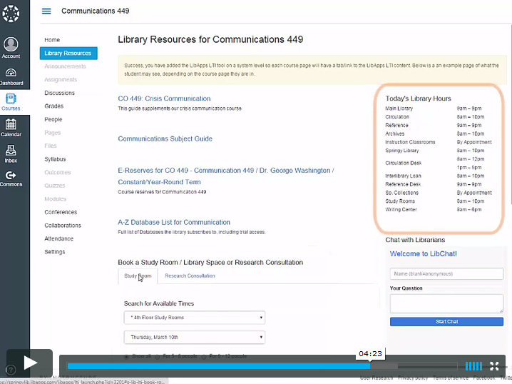

Slide 10
LibApps Integration Tool
Integrations available:
LibGuides
Customizable library page
E-Reserves
Next steps…

Slide 11
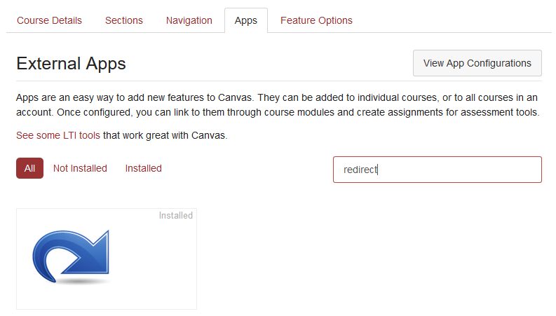
Redirect Tool

Slide 12
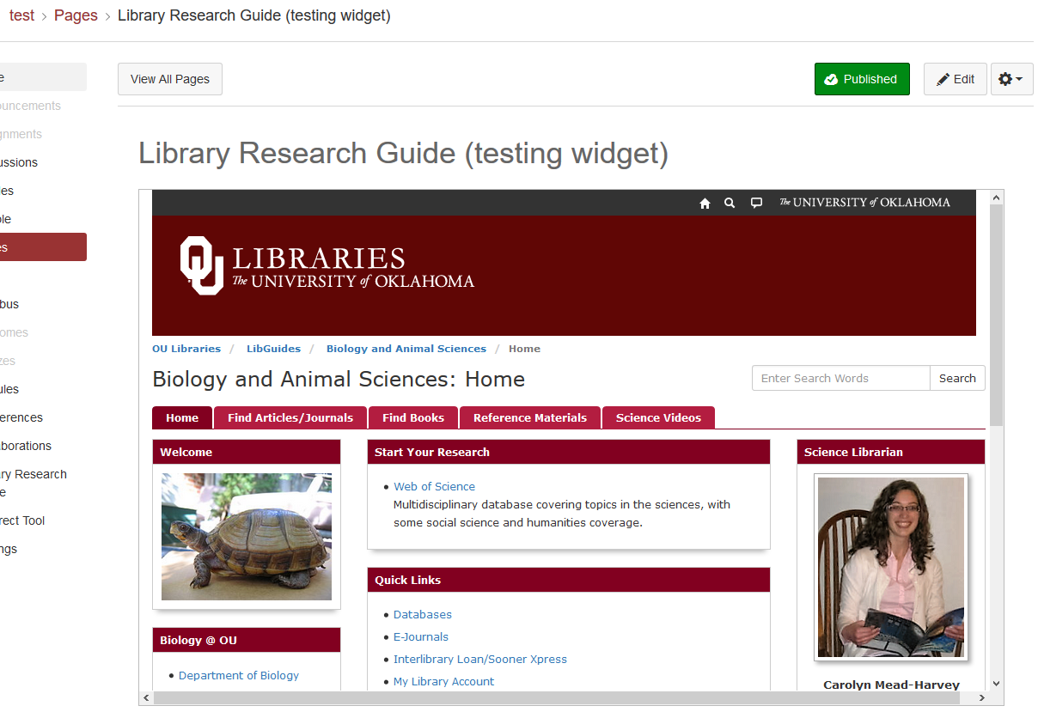
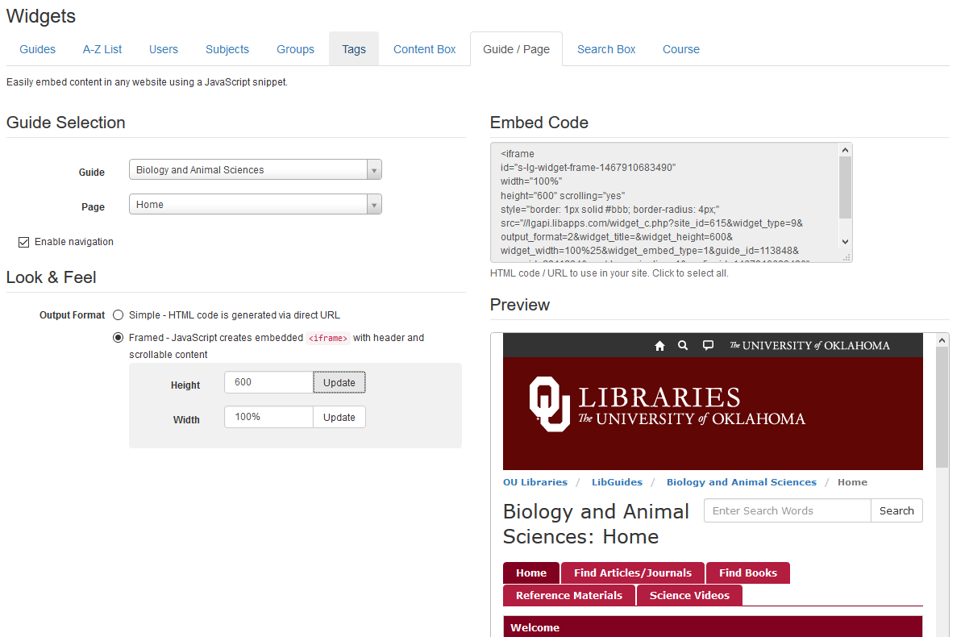
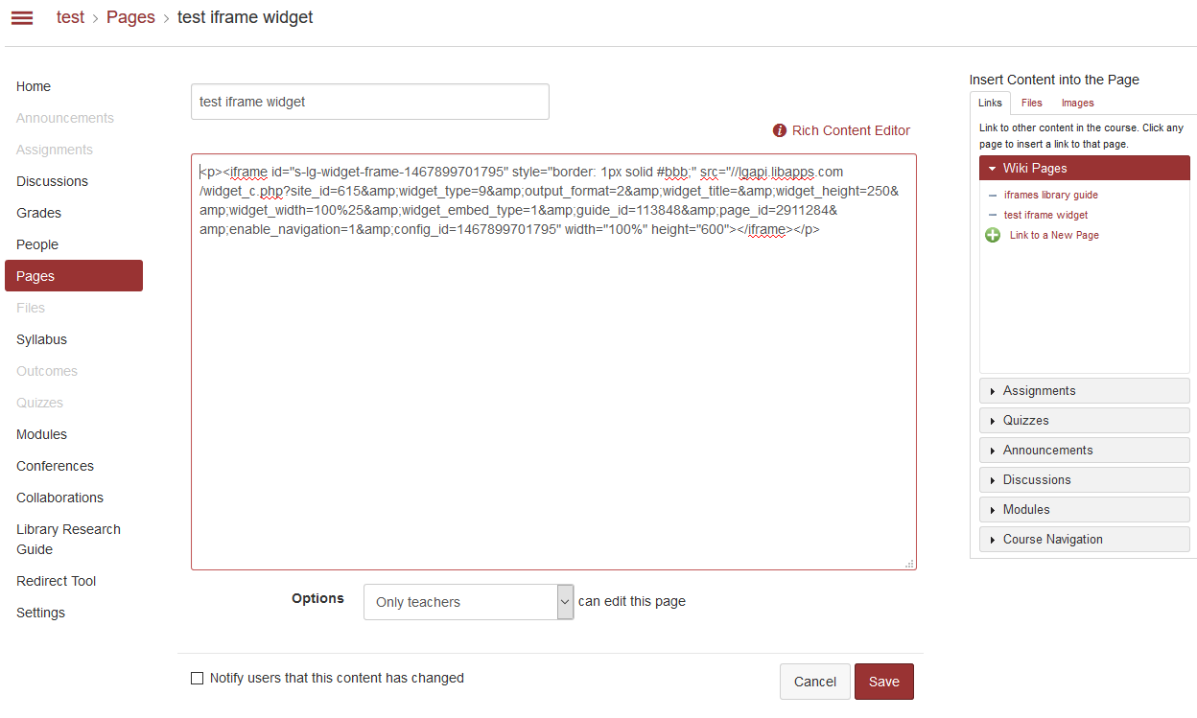
Embed a live website

Slide 13
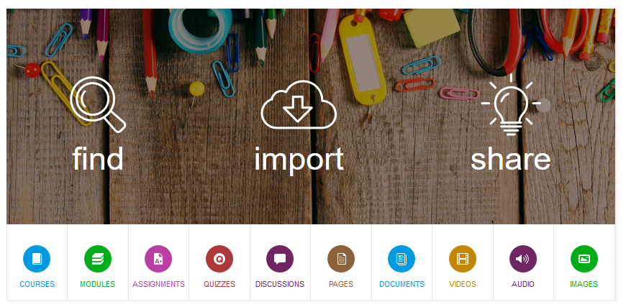
Canvas Commons

Slide 14
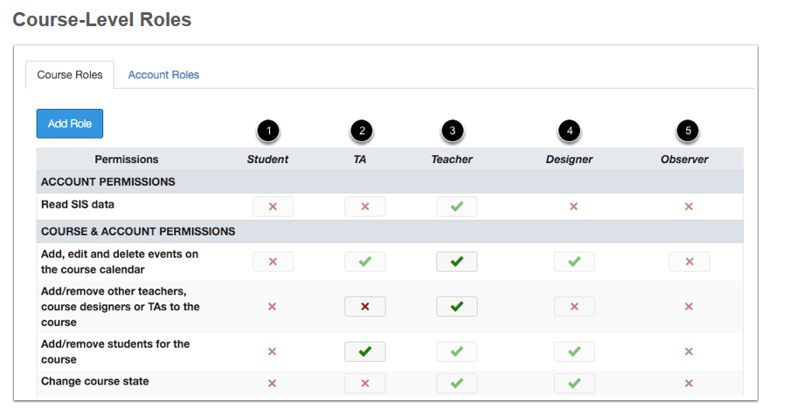
Embed in a course

Slide 15
Training Opportunities
ou.edu/cte

Slide 16
Questions?

