Slide 1
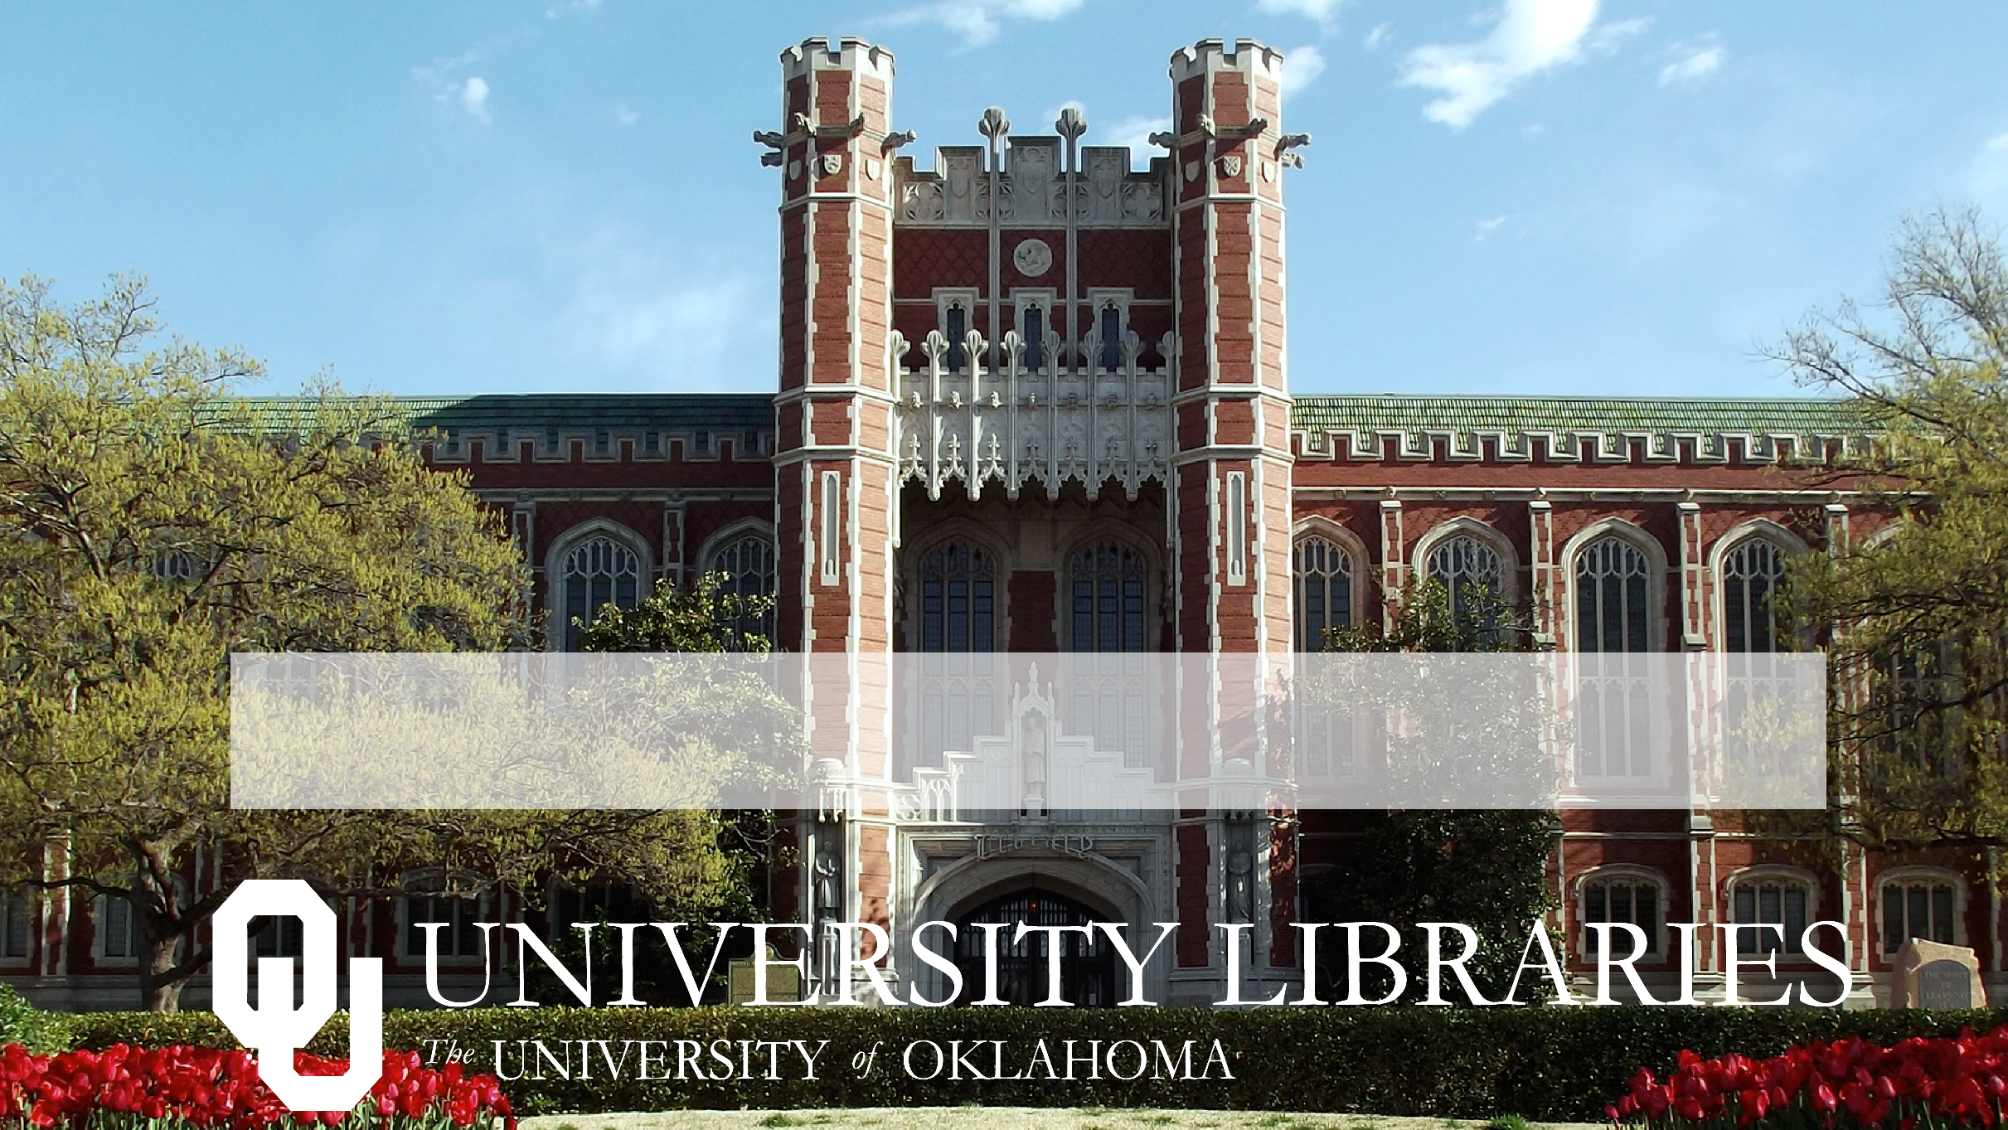
What is Interlibrary Loan?

Slide 2
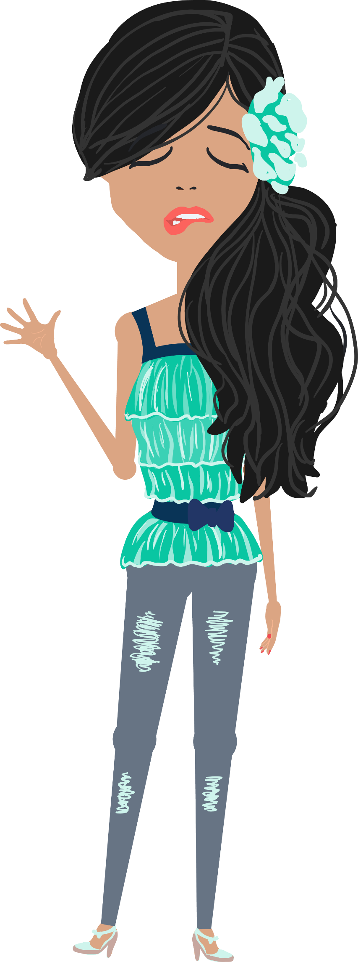
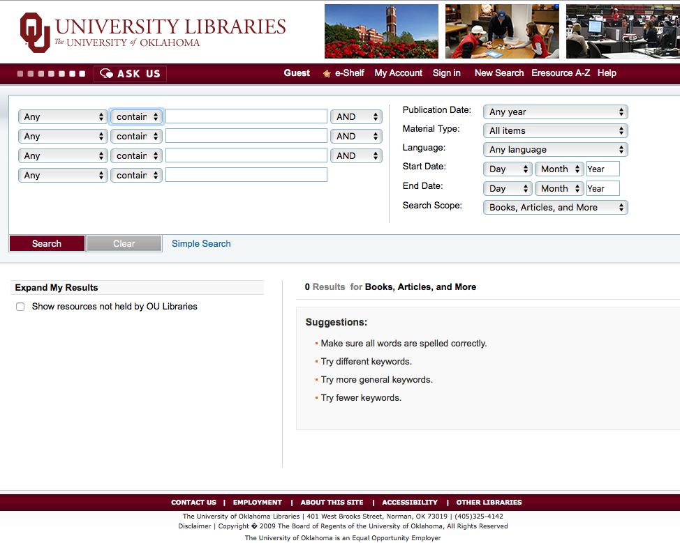
Try using
Interlibrary Loan!
Notes:
Have you ever discovered the perfect book or journal article for your research topic, only to find out that OU Libraries doesn’t own a copy of it? No problem, request that book or journal article through the library’s Interlibrary Loan service.

Slide 3
OU Libraries
ILL Dept.
OU Libraries
ILL Dept.
Notes:
The OU Libraries’ Interlibrary Loan team can get books, articles, and other materials from libraries all over the world.

Slide 4
the handout for more ”Request item via Interlibrary Loan” screen shots!
Notes:
While doing your research, look for the link that says “Request item via Interlibrary Loan.” This link will connect you to an automated form to request those items not owned by OU Libraries.

Slide 5
Notes:
You can also submit Interlibrary Loan requests by clicking on the “My ILL /Sooner Xpress” link in the Quick Links section of the OU Libraries homepage.

Slide 6
Be as specific as possible when filling out the Interlibrary Loan request forms.
Notes:
If you fill out an ILL request form yourself, be sure to select the appropriate form located under New ILL Request and include as much information as you can about the item you are requesting.

Slide 7
https://libraries.ou.edu/ill
for more information on Interlibrary Loan
Notes:
Don’t let “no full text available” or “0 results for books, articles, and more” stop your research! Use Interlibrary Loan!

