Slide 1
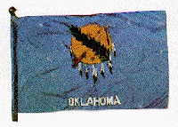
A History of Oklahoma Documents

Slide 2
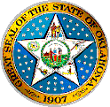
The State of Oklahoma
Oklahoma was the 46th state to be admitted to the Union.
Statehood is November 16, 1907.
Oklahoma means "land of the Red People" in the Choctaw language.

Slide 3
What are State Publications?
"...any informational materials which originate in or are produced with the imprint, by the authority, or at the total or partial expense of an agency supported wholly or in part by state funds and which are distributed to persons outside of the creating agency or are required by law."

Slide 4
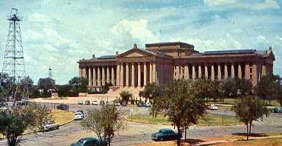
Where Do they Come From?
"...any office, officer, department, division, unit, bureau, board, commission, authority, institution, sub state planning district, or agency in any branch of the state government, and all sub-divisions of each when applicable"

Slide 5
The Value of State Publications
State publications are an important part of the state's policy-making process. They tend to be the most current source for statistical data, and often contain information not available elsewhere.
Topics: consumer, educational, regulatory, recreational, etc…

Slide 6
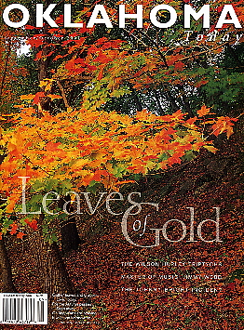
How Do We Collect Them
Every agency…which issues a state publication shall immediately deposit a maximum of twenty-five copies with the Publications Clearinghouse."
Oklahoma Department
of Libraries Oklahoma
Publications Clearinghouse
(OPC)

Slide 7
The Oklahoma Publications Clearinghouse
The OPC was established by legislation in 1978 and charged with the responsibility "to establish an Oklahoma government publications depository library system for the use of the citizens of the State of Oklahoma; to collect state publications from every agency and to retain and preserve permanently copies of all such publications."

Slide 8
OPC Official Duties
To collect state publications from every agency and to retain and preserve them
To compile and maintain a permanent record of state publications
To establish a state publications depository library system

Slide 9
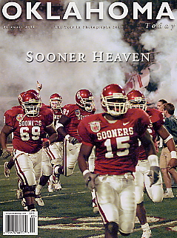
In 1985, the Oklahoma Department of Libraries initiated a program to microfilm state government publications.
This program enabled all depository libraries within the Oklahoma Publications Clearinghouse system to receive copies of all available publications.
Prior to 1985, only six libraries were designated as total depositories within the OPC system, and as such, received copies of all available publications.

Slide 10
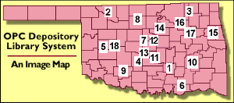
Oklahoma Depositories Today
Most documents disseminated electronically, but still some paper
17 Depositories
across the state,
including Norman,
Stillwater, Tulsa,
Alva, Enid, and
Lawton.

